Slide 1
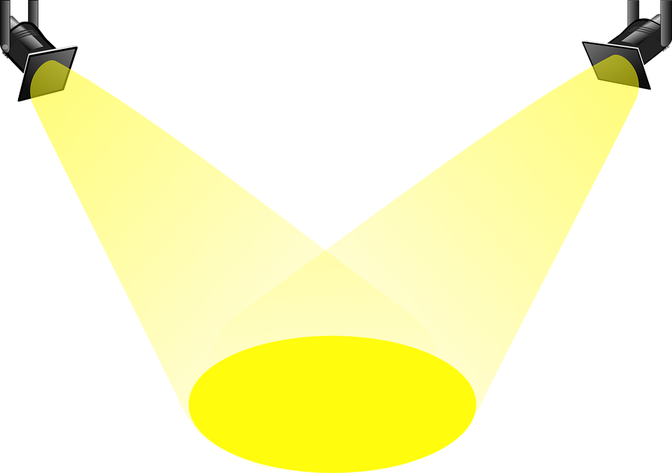
Lighting & Sound project
Play Production
Mr. Donovan

Slide 2
We will now merge what we’ve learned in the areas of Sound & Lighting Design in two fun projects!

Slide 3
DESIGN 1:
Color/Light with Music
Play around with the Color/Light Lab
Choose a SONG that evokes a specific feel/emotion, etc. Royalty-free instrumental music
Play the song, and manipulate the Color/Light Lab as it plays
Record your screen as you execute lighting to your music, then insert the finished video into a slideshow
Explain your design choices in a separate slide
You will create a mood with light, color and music

Slide 4
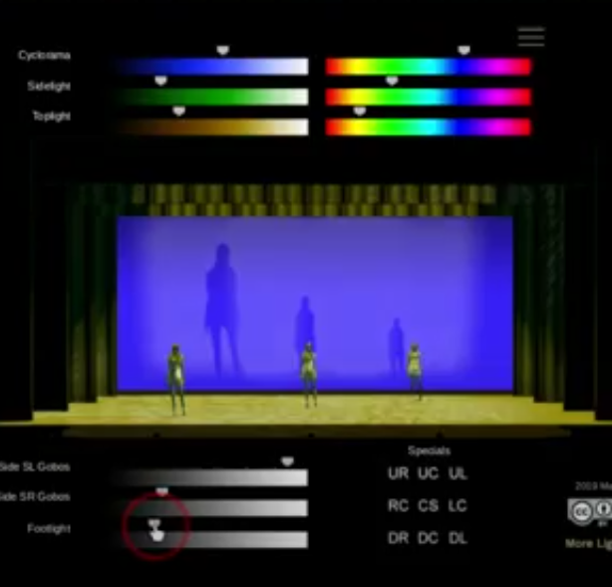
Expectations (Color/Music)
You may play and light the whole song if you like, but you MUST record at least ONE MINUTE of your design
There MUST be at least THREE significant changes in lighting. Changes can be in color, in brightness/darkness, in speed of light… The song should be your guide!
The SCREENCASTIFY extension allows you to record your screen
Take a look at my example

Slide 5
DESIGN 2:
Lighting (Gobos) with Sound Effects
Play around with this GOBO LAB
Find/record sound effects to go along with the scene you’ve set SFX Library Foley SXF ideas
Insert a screenshot of your finished design from the GOBO LAB in your slideshow
Insert an audio file somewhere small but visible on your slide as well to be played with the visual
Explain your design choices in a separate slide
You will create a mood with light, shadows, and
sound effects

Slide 6
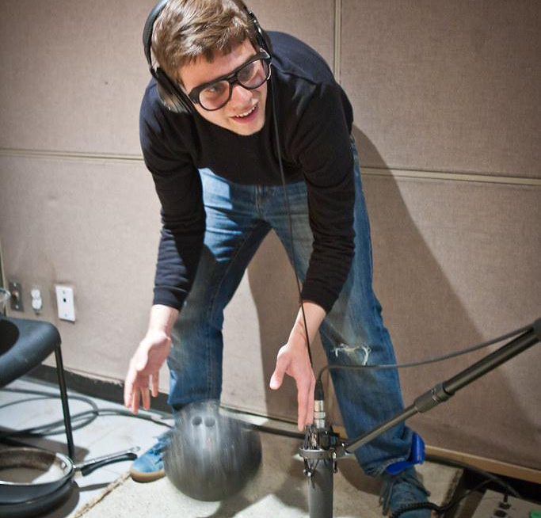
Expectations (Gobo/SFX)
You must have at least:
ONE sustained sound (rain, crackling fire, wind, party sounds, etc.) This should last at least 30 seconds)
ONE isolated effect (thunder, glass breaking, scream, laughter, etc.)
You may record using Screencastify and manipulate the gobos to go along with your effects if you like, but this is NOT required. A still image (screenshot) is fine. (*If you go the moving picture route, consider utilizing the “blackout” feature)
My example:

Slide 7
Resources
SCREENCASTIFY Screencastify tutorial
Audio Editor for Chromebook
Royalty-free instrumental music
Foley SXF ideas
SFX Library
Color/Light Lab
GOBO LAB

Slide 8
HAVE FUN!

